Slide 1
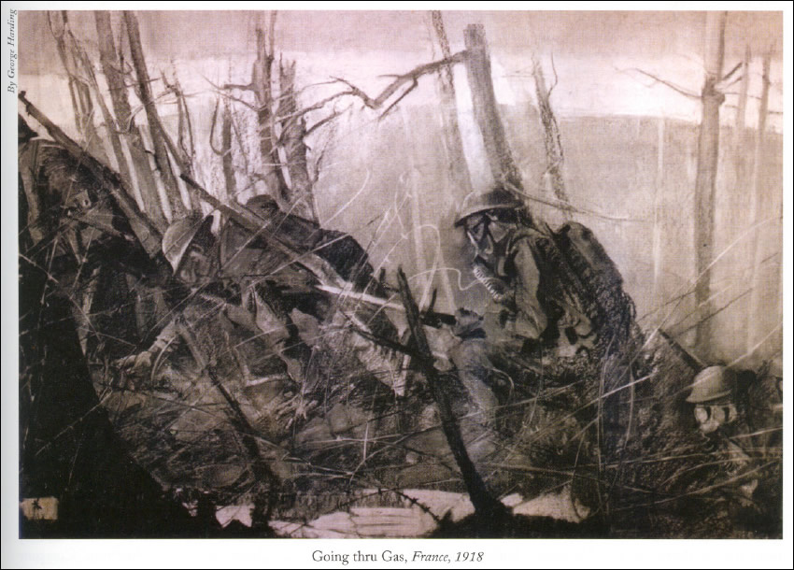
The Battle of Belleau Wood
1-26 June 1918
Keystone Battle Series
Marine Corps History Division
Marine Corps University
gmv1-9/11/15

Slide 2
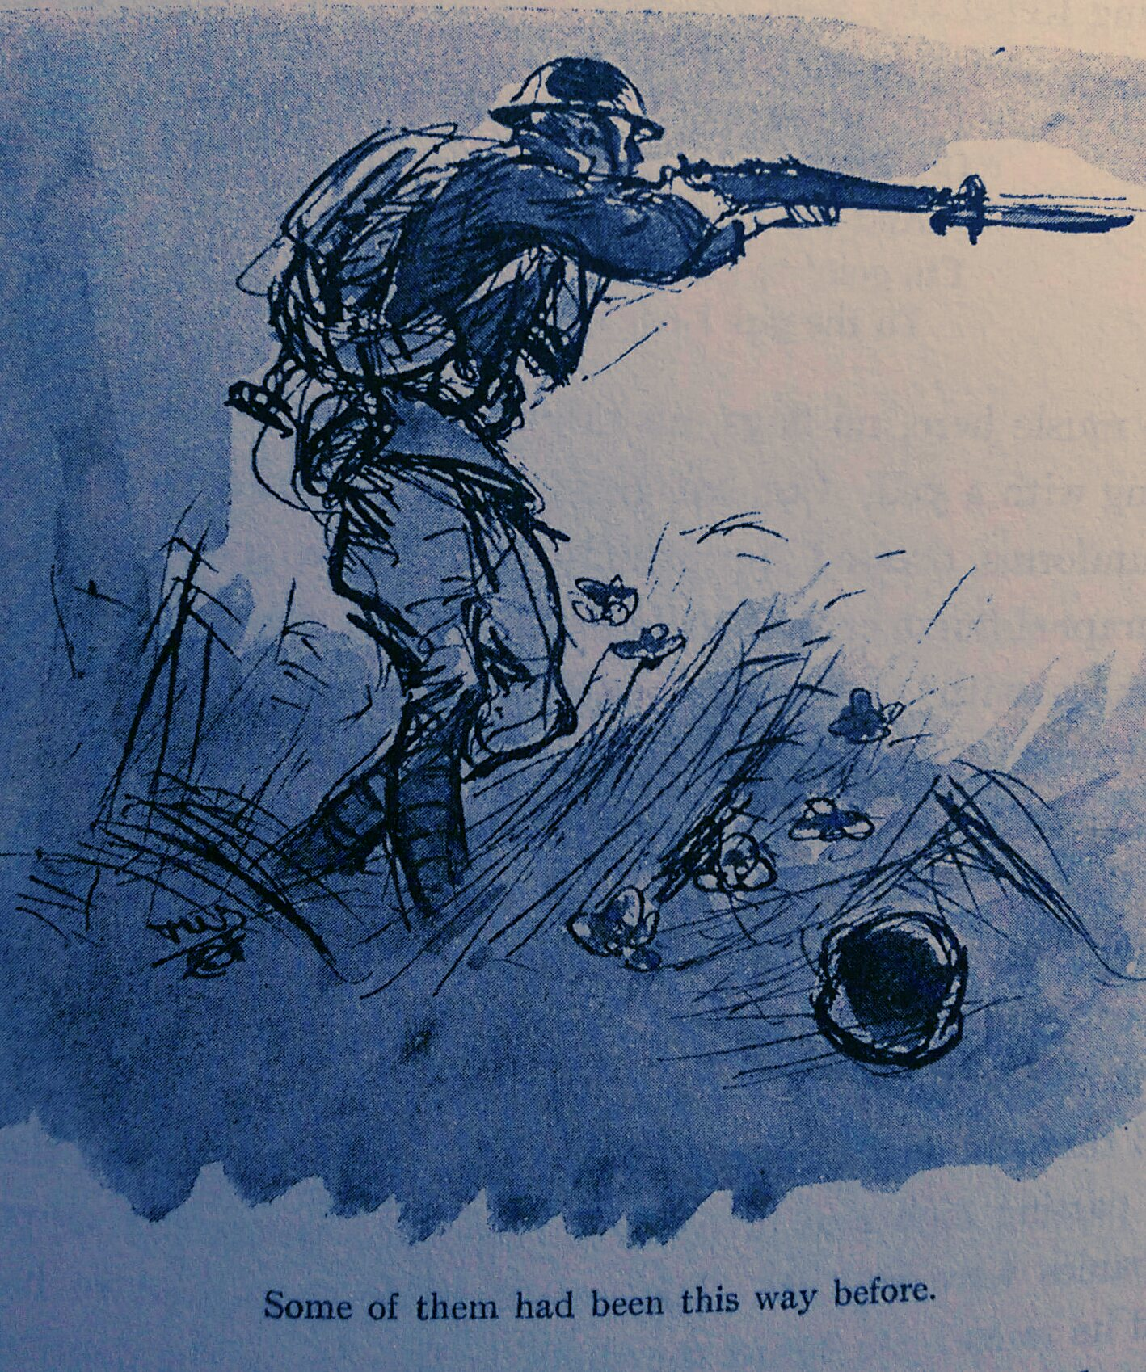
Lecture Outline
I. Introduction: Why Study Belleau Wood?
A. Time, Place, Opposing Forces
B. What Was at Stake
II. Body
A. Commanding Generals: Allied and Opposing
B. Tables of Organization
C. Chronology and Phases of Battle
a. Leading up to the Battle
b. Phase 1: 1-9 June
c. Phase 2: 10-18 June
d. Phase 3: 19-26 June
III. Conclusion
A. Killed In Action (KIA) / Wounded In Action (WIA)
a. Medal of Honor
b. Notable Participants
B. Significance of the Battle to the War
C. Significance of the Battle to the Marine Corps
Fix Bayonets! by John W. Thomason Jr.

Slide 3
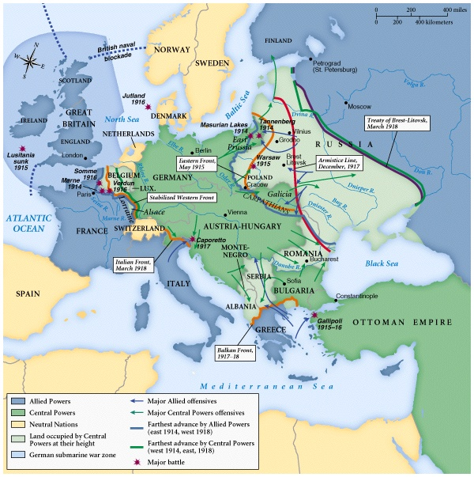
Introduction: Time, Places, and Opposing Forces
Context of Grand Strategy
War in Europe was four years old
Allies (Great Britain, France, Italy) were in trouble
German command launched a massive offensive in the spring of 1918 to finish off the Allies
What was at stake?
Germans believed they could end the war
Initial contact between AEF and German forces; could the Americans fight?

Slide 4
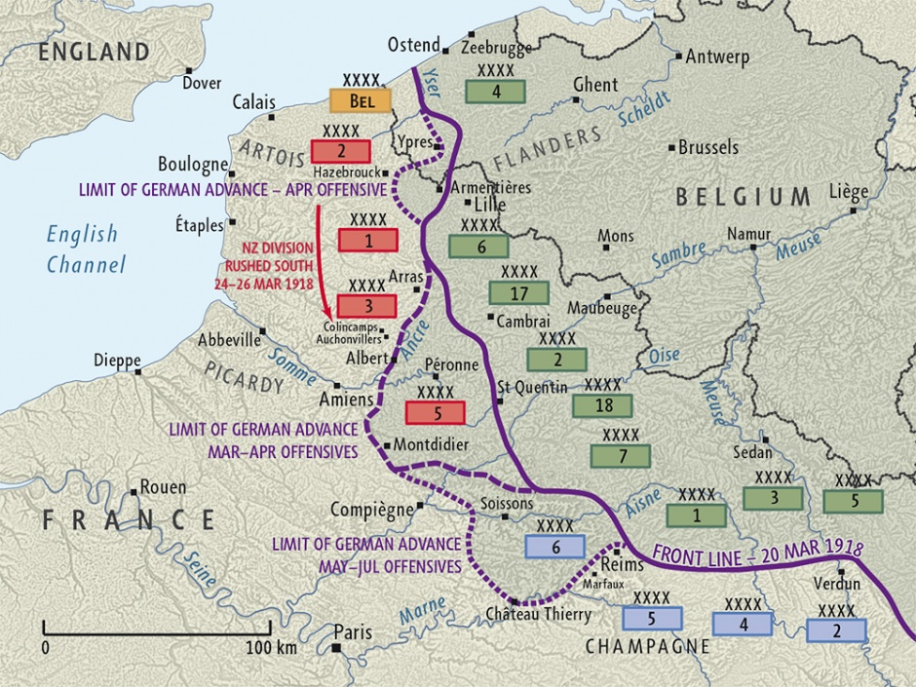
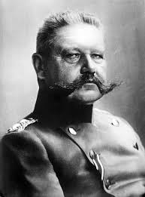
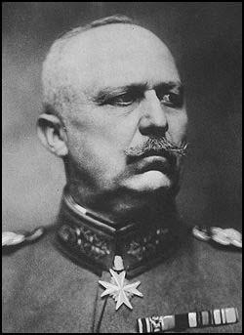
Germany’s Last Offensive: Spring 1918
Orchestrators of Germany’s Last Offensive
Field Marshall
Paul von Hindenburg
General Erich Ludendorff

Slide 5
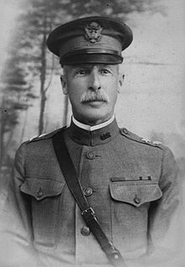
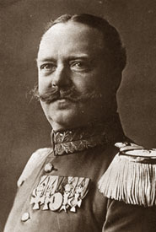
Commanding Generals
American
German
Major General Omar Bundy
General Richard von Conta

Slide 6
Simple Order of Battle and Tables of Organization (T/O)
Army and Division T/O
Brigade and Regiment T/O
6th French Army: Duchene, later Degoutte
XXI French Corps: Degoutte, later Naulin
XXXVIII French Corps
2d U.S. Division: Bundy
Chief of Staff: Brown
2d Field Artillery
3d U.S. Infantry Brigade: Lewis
9th Infantry Regiment: Upton
23d Infantry Regiment: Malone
4th Brigade: Harbord
5th Regiment: Neville
6th Regiment: Catlin, Lee
2d Engineer Regiment
4th Brigade: Harbord USA
Brigade Staff
5th Regiment: Neville
6th Machine Gun Battalion: Cole, Major, Osterhout, Waller
6th Regiment: Catlin, Lee
1st Battalion: Turrill
2d Battalion: Wise, Keyser
3d Battalion: Shearer
1st Battalion: Shearer, Hughes
2d Battalion: Holcomb
3d Battalion: Sibley

Slide 7
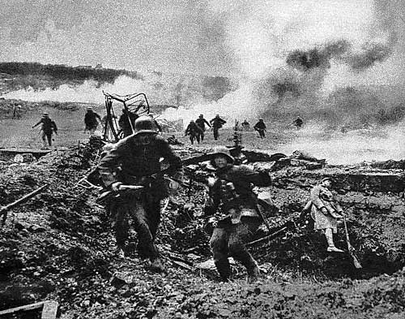
Chronology/Phases of the Battle
Leading up to the battle
18 May 1918: 2d Division moves to positions near Paris because of German successful advances against the French and British.
27 May 1918: Germans launch a surprise attack at Chemin des Dames, roll back the French troops, and drive unchecked to Chateau-Thierry on the Marne River east of Paris.

Slide 8
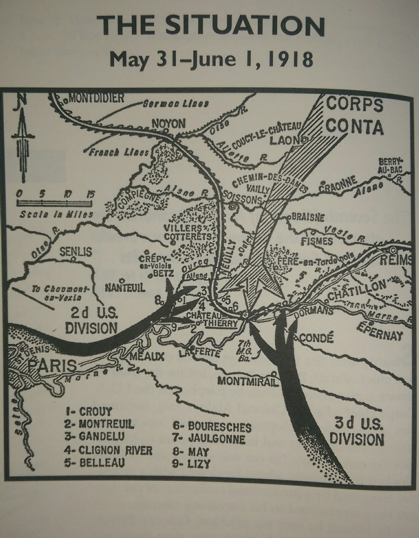
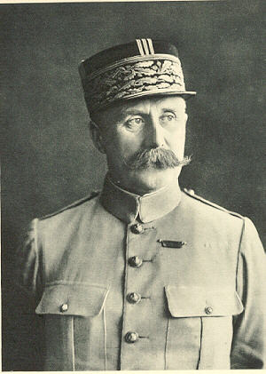
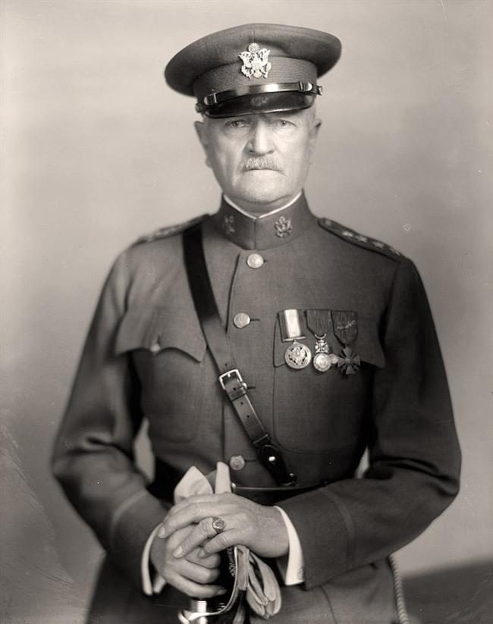
General Phillippe Petaine calls on dozens of Allied divisions, including the U.S. 2d division, to move into the Chateau Thierry Region
30 May 1918: 2d Division begins moving up to check the German advance.
Orders were that “no retirement will be thought of on any pretext whatsoever.”
Gen Petaine
Gen Pershing

Slide 9
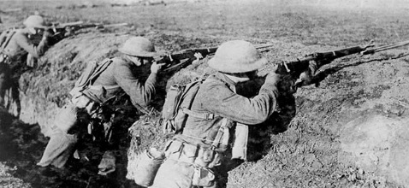
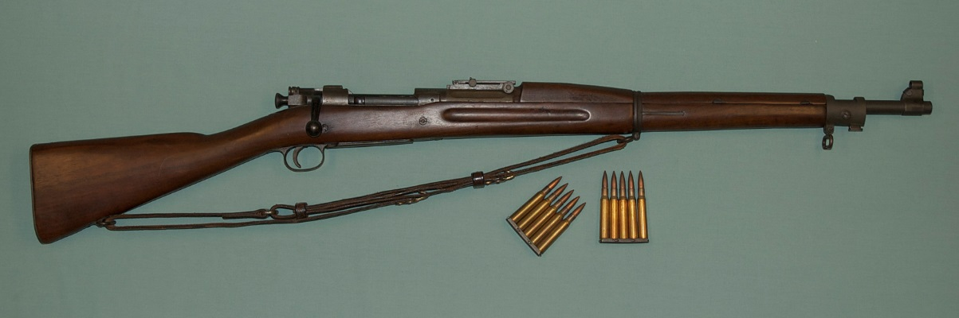
German advance halted between 1 and 5 June
German assault divisions had lost much of their offensive punch by the time they occupied Bouresches and Belleau Wood.
Nevertheless they attacked Marine positions on the 3rd, 4th and 5th of June.
Marine marksmanship with the Springfield model 1903 rifle and machine guns repulsed these attacks.
Marines in defensive positions
U.S. issued Springfield model 1903

Slide 10
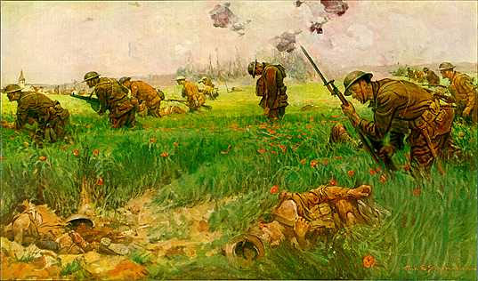
Phase I: 1-9 June
Through the Wheat

Slide 11
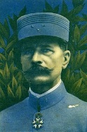
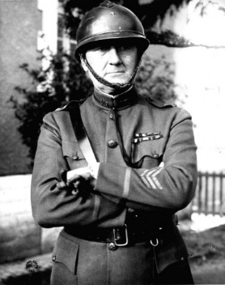
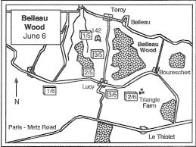
5 June 1918: French XXI Corps Commander, Brigadier General Jean Marie J. Degoutte, ordered the 2d Division to advance the following day to seize better defensive ground.
4th Brigade Commander, BGen James G. Harbord (USA), ordered 1/5 to take Hill 142, a small elevation west of Belleau Wood. The attack kicked off at 0345.
BGen Degoutte
BGen Harbord

Slide 12
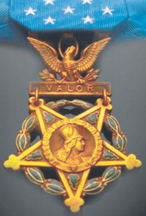
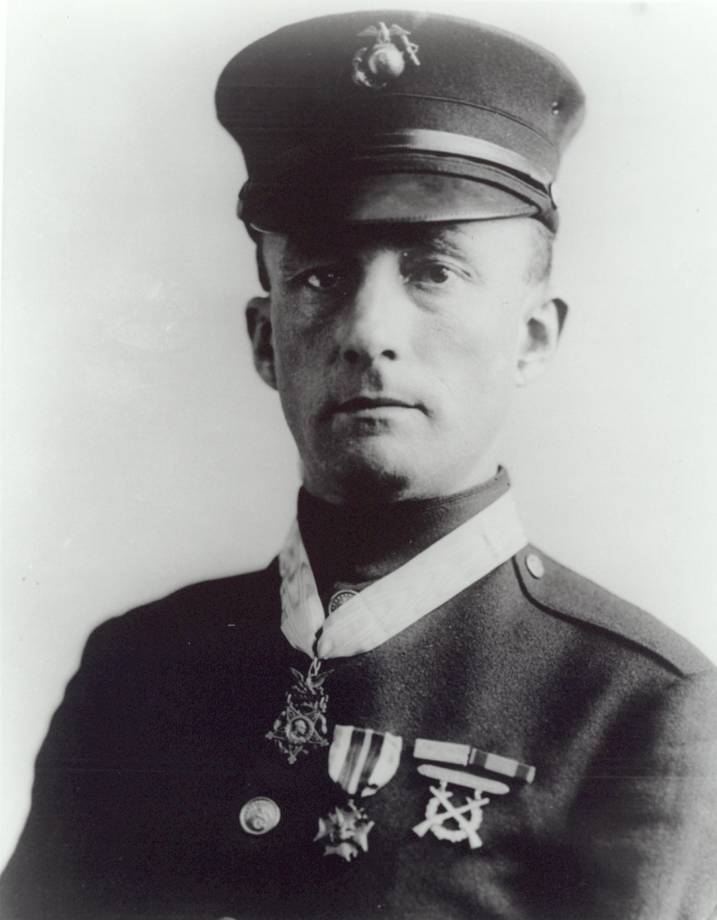
Gunnery Sergeant Ernest A. Janson* and Hill 142, 6 June 1918
Despite heavy casualties, 1/5 seized the hill and defended against several counterattacks. During the fighting on Hill 142, GySgt Ernest A. Janson earned an Army Medal of Honor “for conspicuous gallantry and intrepidity above and beyond the call of duty” as well as the Navy Medal of Honor.
* Served under the name Charles Hoffman

Slide 13
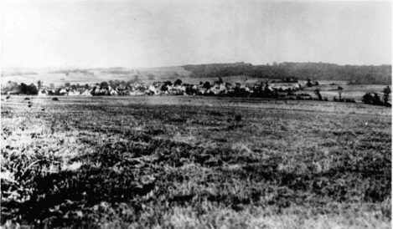
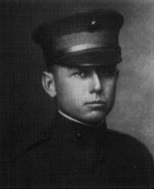
Then Harbord ordered an attack on the afternoon of 6 June to seize Belleau Wood and the village of Bouresches, just southeast of the wood.
The 96th Company (2/6) attacked and captured Bouresches but suffered over 50% casualties.
Assault position of 2/6 looking toward Bouresches
Lt Clifton B. Cates, 96th Co

Slide 14
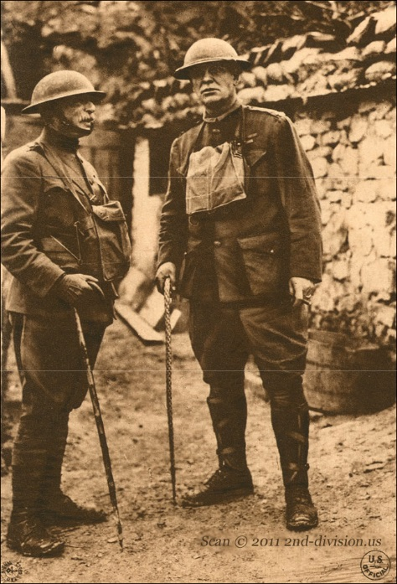
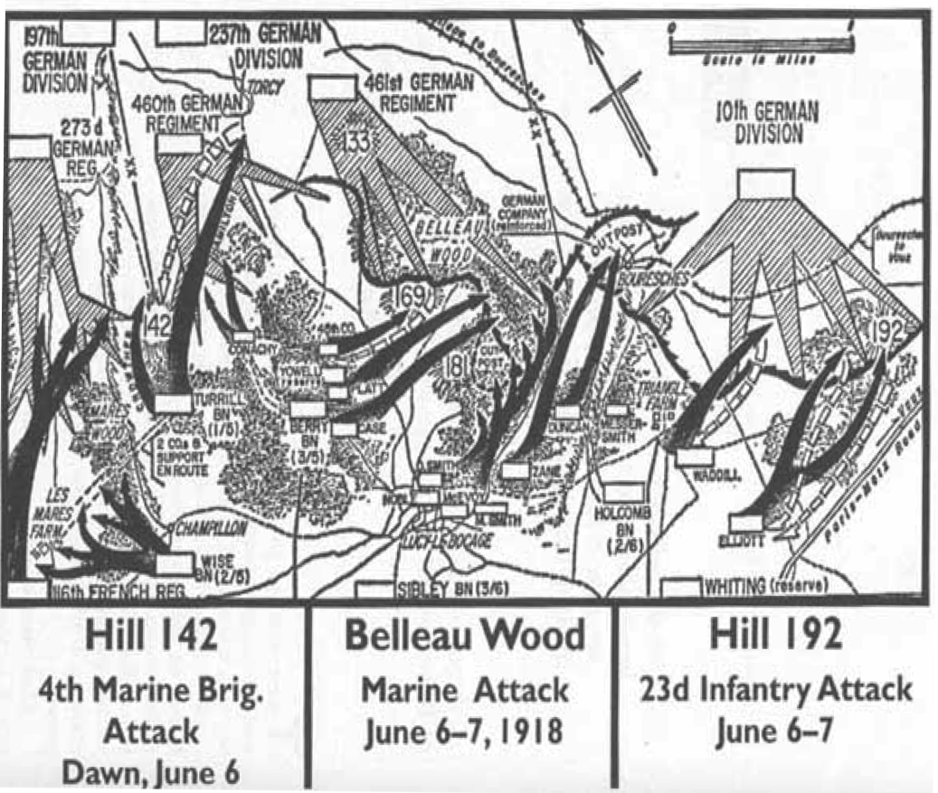
At H-hour, Marines formed up and began the assault through the wheat fields toward Belleau Wood.
3/5 and 3/6 suffered heavy casualties from the assault and only small elements of each made it to the woods.
MajGen Omar Bundy / Col Albertus Catlin

Slide 15
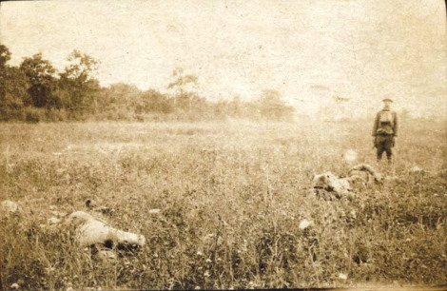
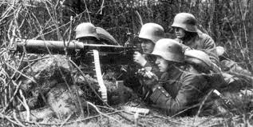
Despite successes taking Hill 142 and Bouresches on 6 June, the brave assaults into Belleau Wood faltered under withering German machine gun fire. Marines had 1,087 casualties.
Harbord would have to alter tactics to gain a foot hold in the wood.
Left: Marine dead in wheat field, their objective in the background. Right: German machine gun position.

Slide 16
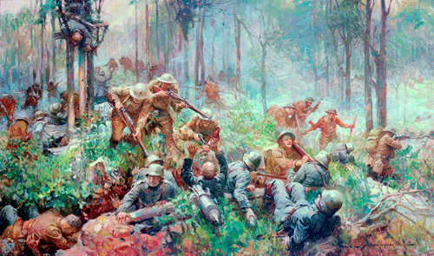
Phase II: 10-18 June
Into the Woods

Slide 17
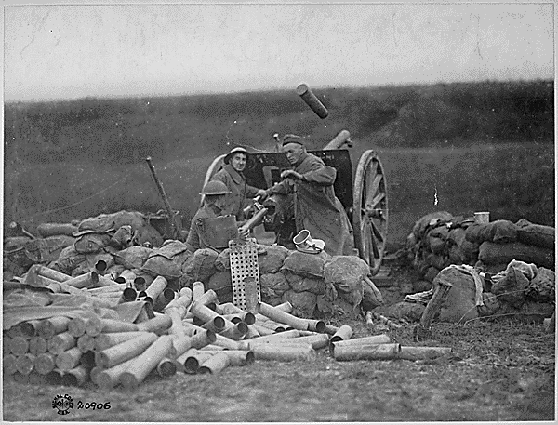
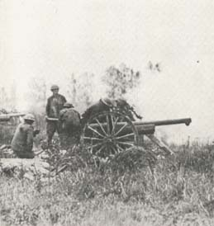
Beginning the morning of 9 June, artillery bombarded German positions in Belleau Wood for over 24 hours with 28,000 75mm and 6,000 155mm shells expended.
Gen Harbord also used the town of Bouresches to set up 12 machine gun positions to fire into the German’s eastern flank and box them in.
U.S. 75mm guns in action. The barrage of 9-10 June marked a shift toward a much more intense and effective use of artillery by the 2d Division and 4th Brigade.

Slide 18
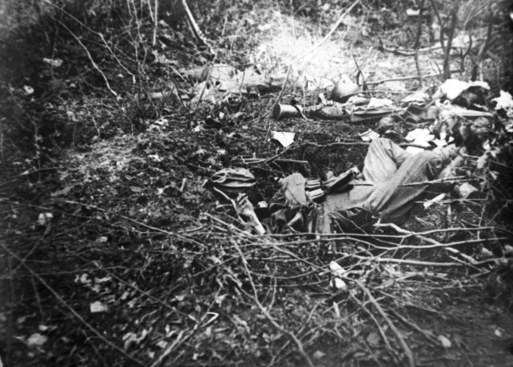
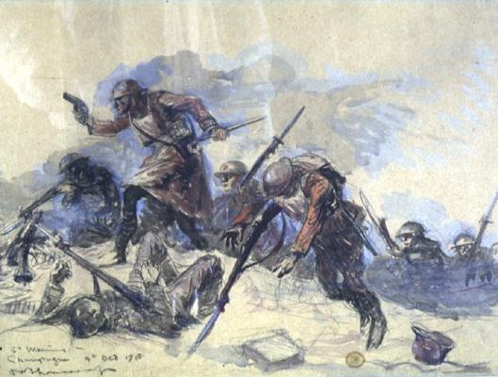
The bombardment and subsequent rolling barrage kept the Germans’ heads down and damaged their defensive positions.
At 0430 the morning of 10 June, Marines rushed into the wood and engaged the Germans in close combat.
German soldier who died at his post. / Thomason’s interpretation of Marines on the attack.

Slide 19
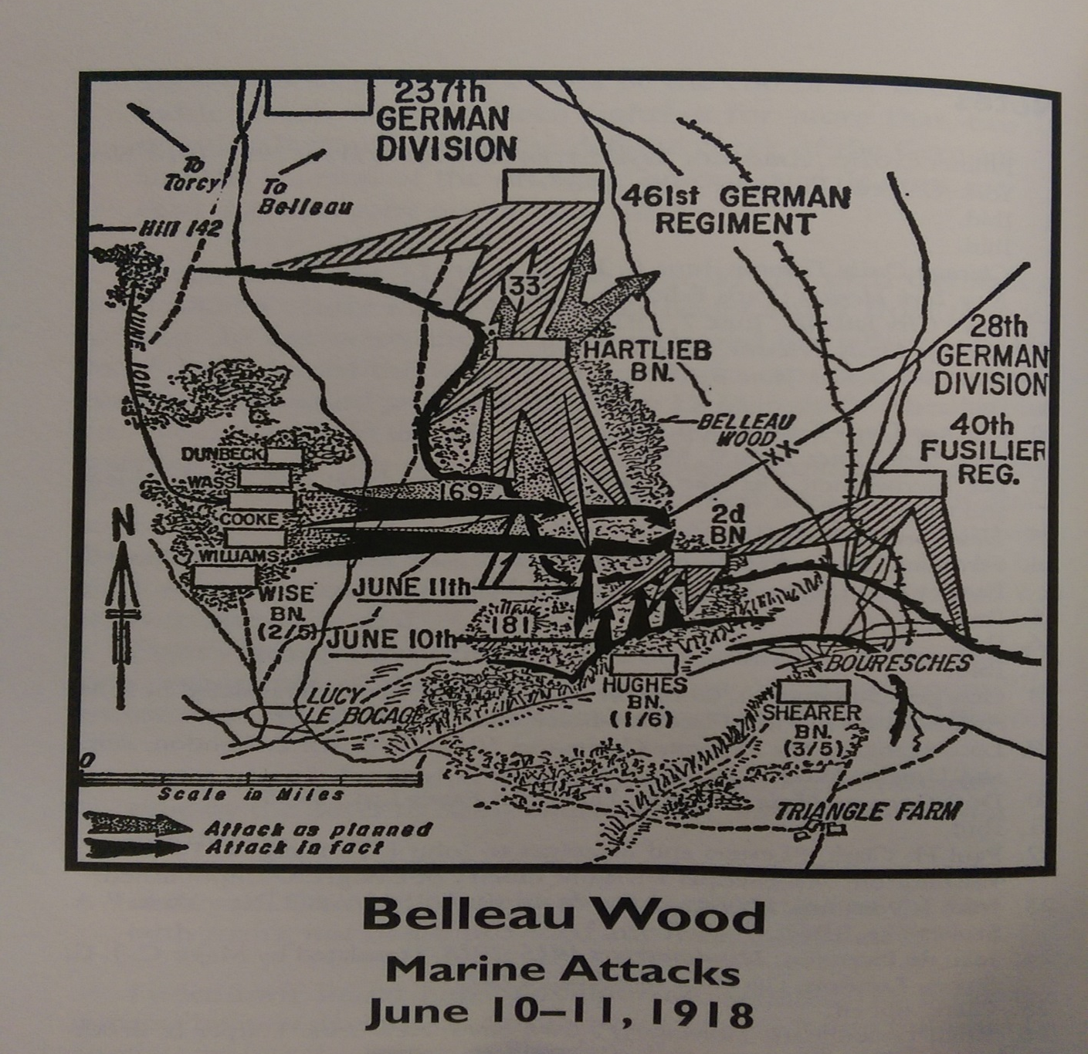
Phase II Fighting in the Woods
Into the woods, the advanced slowed as companies encountered German positions.
Small unit warfare.
Map: notice the differences between the planned attacks and actual ones.

Slide 20
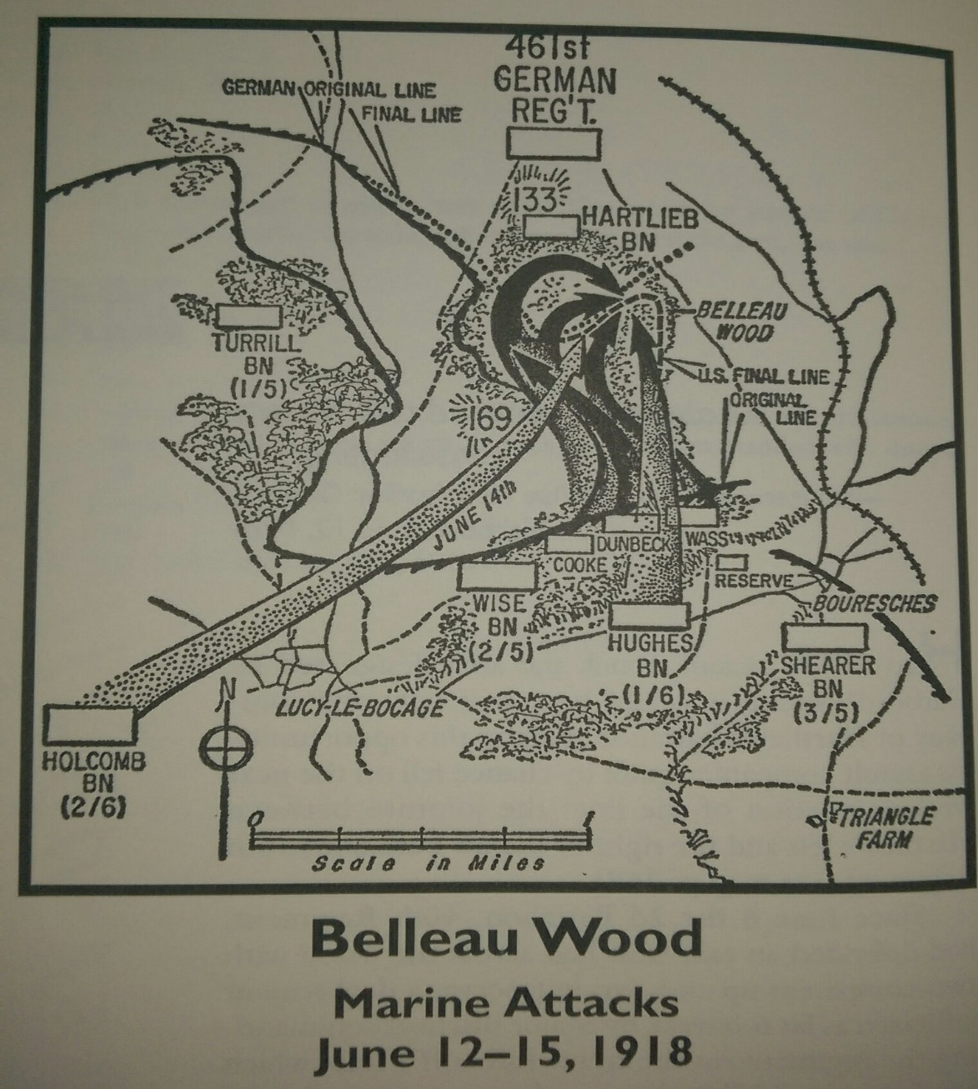
Phase II Fighting in the Woods
Heavy casualties on both sides.
Marines mistakenly reported having seized all objectives.
This misunderstanding gave the Germans time to reinforce their positions.

Slide 21
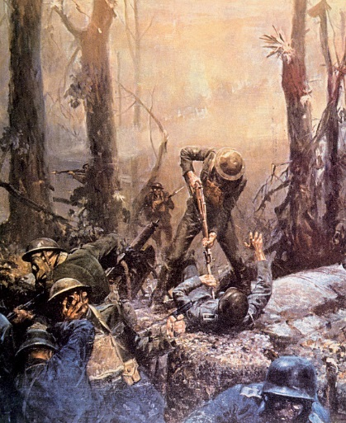
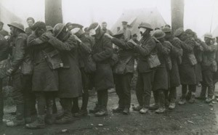
15-18 June: Both sides consolidated positions. Germans reinforced their positions in the northwest corner of the woods.
Heavy barrage of gas and artillery fell on Marines in the woods.
U.S. gas victims
Small unit warfare

Slide 22
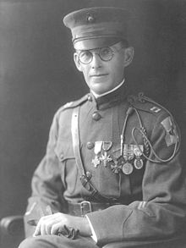
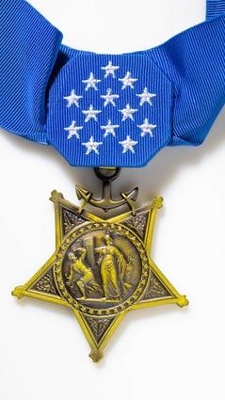
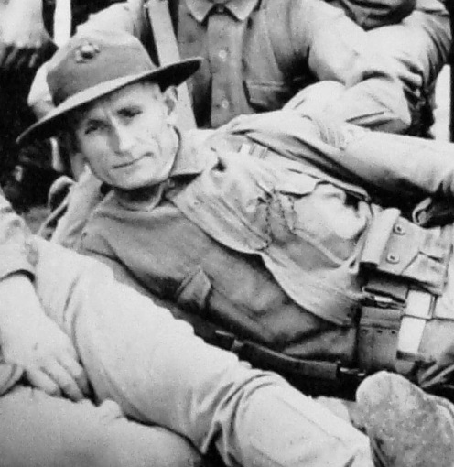
Medal of Honor Recipients 10-18 June
Lieutenant Orlando H. Petty USNR
Gunnery Sergeant Fred W. Stockham

Slide 23
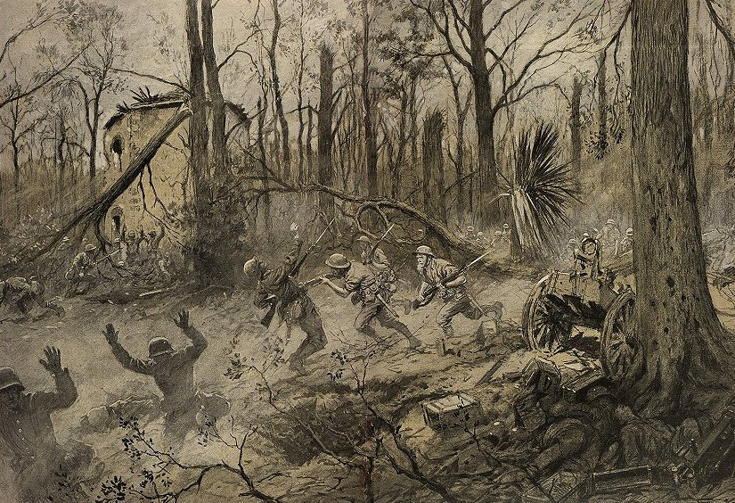
Phase III: 19-26 June
Bois de la Brigade de Marine

Slide 24
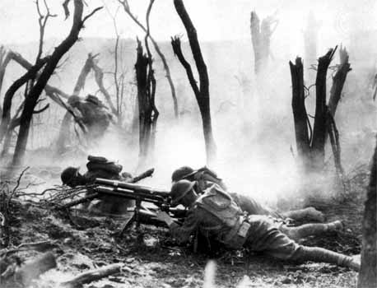
Interservice Rivalry?
1st Battalion, 7th Infantry (Army), called in from 3d Brigade to relieve 2/6, failed to take German positions on 20-23 June.
Harbord accused LtCol Adams (1/7 CO) and his troops of being incompetent (unfairly) and called in 3d Battalion, 5th Regiment, (Shearer CO) to finish the job.
The Germans repulsed 3/5 as well but the Marine battalion did not receive the same controversial rebuke from Harbord as 1/7 did.
Machine gunners of the 23d Infantry
near Chateau Thierry

Slide 25
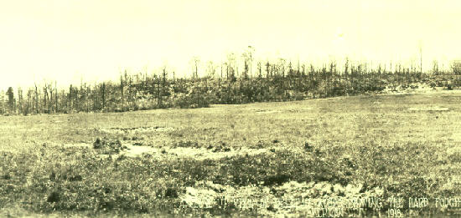
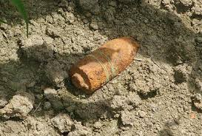
Effects of Artillery Fire on the Wood
1/7 and 3/5’s failures prompted Harbord to repeat the tactics of 9-10 June: Heavy bombardment of German positions followed by rolling barrage in support of infantry attack.
Left: Unexploded ordinance still being found at Belleau Wood; Right: Belleau Wood after the battle.

Slide 26
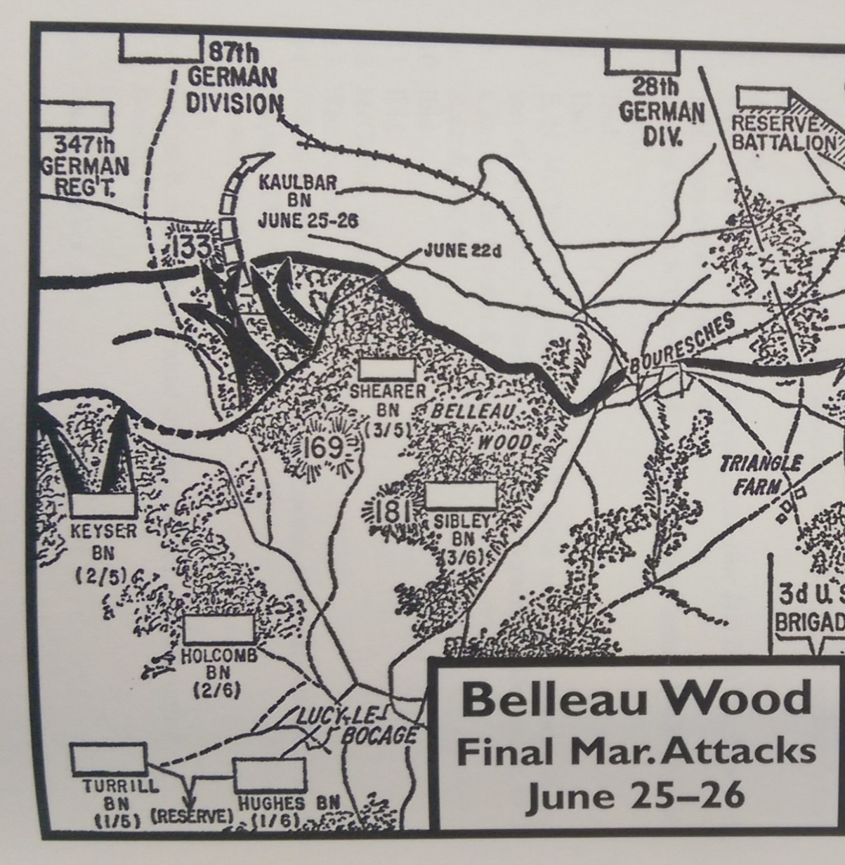
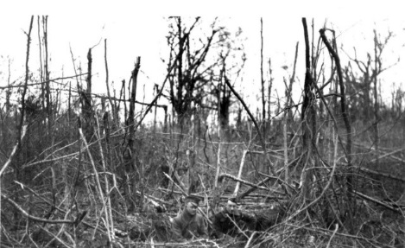
Phase III Final Assaults
Like the bombardments that kicked off Phase II, the 18 hour bombardment worked.
3/5 advanced much more efficiently.
German troops of the 374th Regiment evacuated the wood.

Slide 27
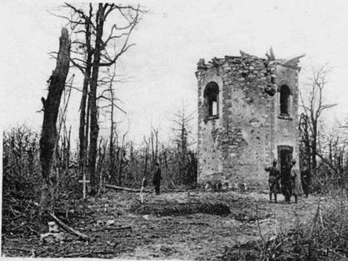
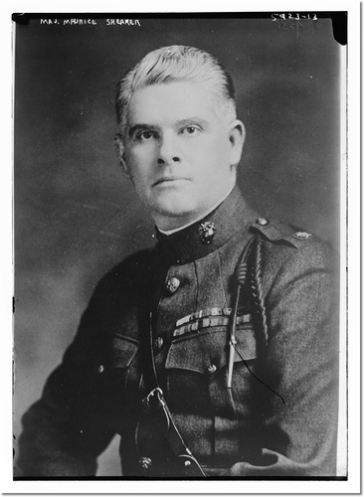
The morning of 26 June, 3/5’s Battalion Commander, Major Maurice Shearer, sent a message to General Harbord: “Belleau Woods now U.S. Marine Corps’ entirely.”
Left: Maj Shearer, 3/5’s CO; Right: Hunting lodge in northern section of the wood that changed hands between Germans and Marines numerous times.

Slide 28
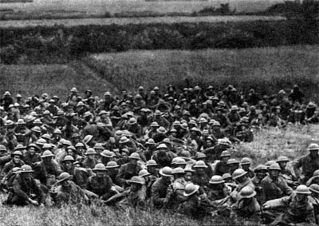
Conclusion
Casualties
Medals of Honor
Strategic Significance
Significance to the Marine Corps
Famous Participants
Survivors of 2/6 at rest after the battle

Slide 29
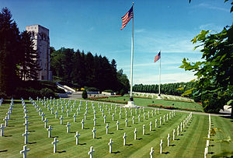
Casualties: 4th Brigade
Unit | KIA | WIA | Gassed | Died of Wounds | Total
5th Regiment | 404 | 1410 | 225 | 198 | 2237
6th Regiment | 186 | 940 | 650 | 122 | 1898
6th Machine Gun Battalion | 26 | 101 | 27 | 12 | 166
Misc | 5 | 17 | 2 | 2 | 26
Totals | 621 | 2468 | 904 | 334 | 4327
Marine casualties from all other U.S. conflicts leading up to WWI: KIA 325, WIA 481, Total 806.
Marines would eventually have 2,461 KIA and 9,520 WIA out of a total of 350,000 U.S. casualties in WWI.
A perspective about Allied WWI casualties: France, 6.1 mil; United Kingdom, 3.1 mil; Italy, 2.1 mil; Russia 9.15 mil.

Slide 30
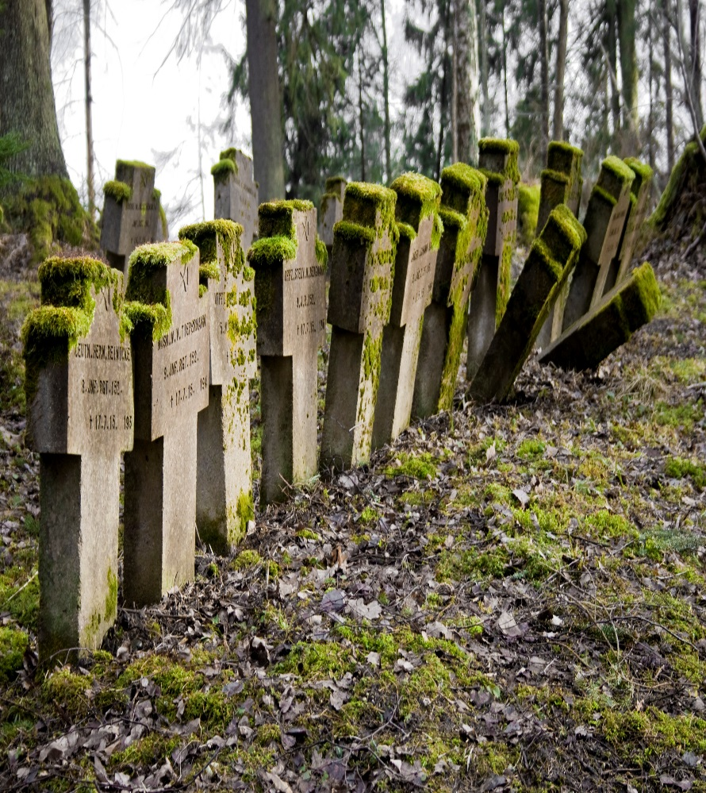
German Casualties
Unit | KIA | WIA | Total | Period
237th Div | 322 | 1145 | 1467 | 6-16 June
10th Div | 39 | 181 | 220 | 6-10 June
28th Div | 410 | 1245 | 1655 | 10-13 June
87th Div | 110 | 66 | 176 | 16-25 June
Totals | 881 | 2,637 | 3518 | 6-25 June
Total German Casualties WWI: 7.1 Million, 65% of men mobilized.

Slide 31
Medals of Honor
GySgt Ernest A. Janson
GySgt Fred W. Stockman, Posthumous
Lt Orlando H. Petty, Medical Corps, USNR
Lt (jg) Weeden Osborn USN, Posthumous
143 Navy Crosses

Slide 32
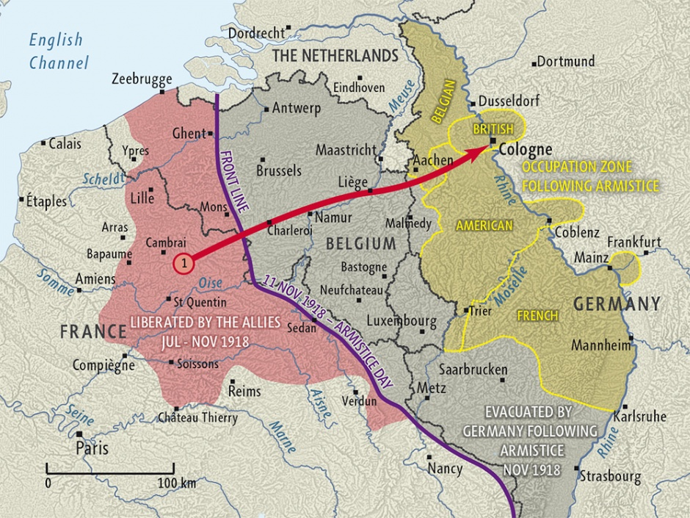
Strategic Significance
German army remained on the defensive until the armistice.
Allied armies began rolling back German gains.
AEF played an important role in this process during the Summer and Fall of 1918.
“The tremendous superabundance of pent-up, untapped nervous energy which America’s troops brought into the fray more than balanced the weakness of their allies, who were utterly exhausted.” Gen Erich Ludendorff, 18 July 1918.

Slide 33

Significance of the battle for the Marine Corps
Belleau Wood was a turning point for the USMC for several reasons.
Tactically: Gave a core cadre of officers and enlisted men experience in large scale combat operations and modern war (by WWI standards).
Heavy artillery barrages coordinated with infantry assault
Employment of machine guns in defense and offense
Field fortifications
Chemical warfare
Navy corpsman gained vast medical experience
Marines with captured German mortar

Slide 34

Significance for the Marine Corps . . .
Soon after Belleau Wood, Gen Pershing appointed MajGen John A. Lejeune as the commander of the U.S. 2d Infantry Division.
Lejeune was the first Marine to command a U.S. army division in war.
Despite working together successfully, soldiers, Gen Pershing included, resented the fact that Marines received so much public adoration after the war.
Left: MajGen Lejeune; Right: Gen Pershing

Slide 35




Significance for the Marine Corps . . .
French Government renamed the wood to Bois de la Brigade de Marine.
5th and 6th Regiments awarded the French Fourragére.
Left: Belleau Wood Plaque
Right: French Fourragére in WWII era and present

Slide 36


Future leaders of the Marine Corps
June 1918: Graves Erskine (third from left); Thomas Holcomb (fifth from right); Clifton Cates (fourth from right)
Erskine and Cates decades later.

Slide 37







Future Commandants who fought at Belleau Wood
General Wendell C. Neville 14th CMC 1929-1930
Belleau Wood: Colonel, CO 5th Regiment
General Thomas Holcomb 17th CMC 1936-1943
Belleau Wood: Major, CO 2/6
General Clifton B. Cates
19th CMC 1948-1951
Belleau Wood: Lt, 96th Co. 2/6
General Lemuel C. Shepherd, Jr.
20th CMC 1952-1955
Belleau Wood: Lt, 55th Co, 2/5

Slide 38



Division Commanders at Iwo Jima who fought at Belleau Wood
Iwo Jima:
MajGen Graves B. Erskine, CG 3d MarDiv
Belleau Wood:
Lt, 79th Co. 2/6
Iwo Jima:
MajGen Clifton B. Cates, CG 4th MarDiv
Belleau Wood:
Lt, 96th Co. 2/6
Iwo Jima:
MajGen Keller E. Rockey, CG 5th MarDiv
Belleau Wood:
Captain, 1/5 (XO)
Iwo Jima:
LtGen Holland M. Smith, Commander ATF
Belleau Wood: Major, 4th Brigade Adjutant

Slide 39




Other Notable Participants
GySgt Dan Daly
Lt. John Thomason Jr.
SgtMaj John Quick
Capt Lloyd Williams

Slide 40




Marine Image and Public Relations
Teufel Hunden: Devil Dogs
Devil Dog Fountain at Belleau Wood

Slide 41




Marine Image and Public Relations

Slide 42

Researched and written by
Mark R. Folse
PhD Candidate, University of Alabama (Dept of History)
As part of his internship with, and under the direction of the History Division

